Slide 1
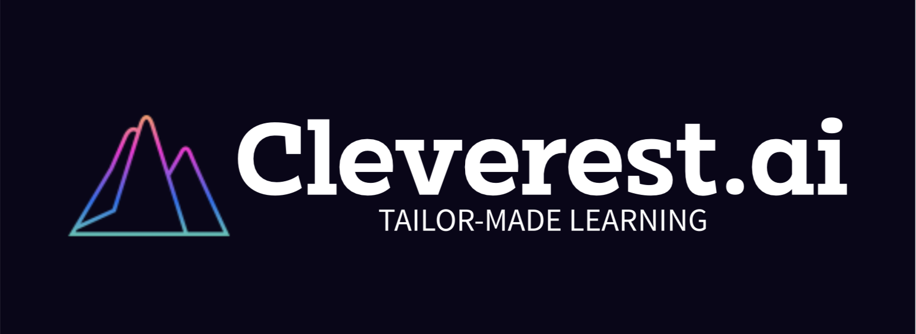
Cleverest.ai
Pitch Deck
MGT 5804 : AI Automation Project
Abhay Pai

Slide 2

Company Overview
Cleverest.ai
What does it do?
A portmanteau of the words ”clever” and “Everest”
It is an AI-powered Personalized Learning SaaS platform that integrates with learning management systems (LMS) like Canvas and Moodle to provide a data-driven personalized learning experience for learners at all stages of life.
Notes:
A portmanteau of the words ”clever” and “Everest”, which aligns with the company’s goal of enabling the learners to maximise their learning and reaching their peak potential

Slide 3
Strategic Problems and Solutions
GPT model to web-scrape files and add to the library.
Implement AI-based models for dynamic resource allocation and AI-based anonymization techniques
Inaccurate personalization and Adaptive Learning.
Sparse learning content library with irrelevant material.
Issues with mainstream market adoption
Unreliable platform with scalability and data privacy issues
ML algorithm to analyze student data and identify type of student.
AI model to analyze user behavior data and augment UI/UX

Slide 4
Customer Segmentation Strategy
Main adopter segment
Target Customers:
Early adopters.
Educational Institutions and Instructors.
Niche customer segment
Revenue Model
Online schools and virtual learning platform
Freemium subscription model, with tier-based pricing
Notes:
Main adopter segment: Early adopters. Early Adopters are typically tech-savvy and are willing to take risks on new technologies and appreciate the potential benefits they can provide.
Target Customers:
Educational Institutions and Instructors. They will allow the end-user (learner) to access the learning platform
Niche customer segment:
We will target online schools and virtual learning platform because they are generally tech-savvy and require extra help to manage virtual students. This will help Cleverest to gain a foothold in the market and boost their bid to go mainstream. Revenue Model:
Freemium subscription model, that helps in faster customer acquisition and lower barrier to entry for customers, and later exploiting switching costs as they upsell tiers since institutions are now intertwined in Cleverest’s ecosystem.

Slide 5
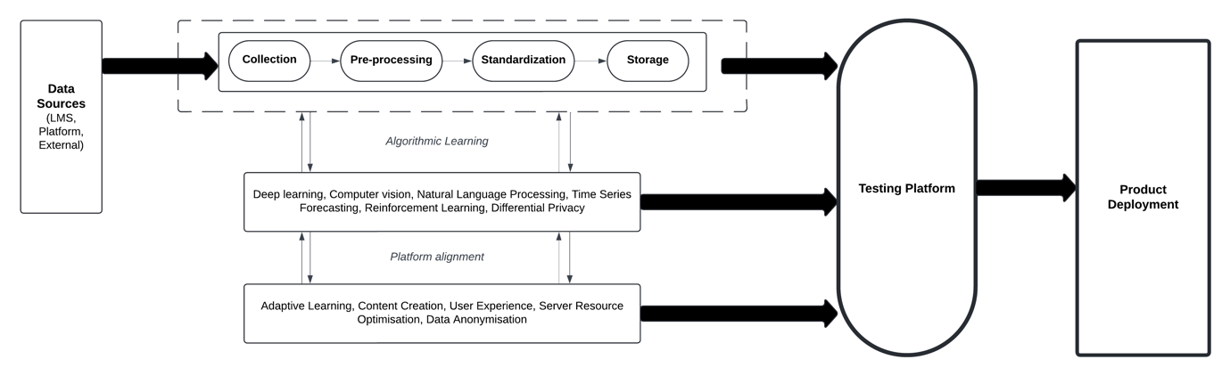
Data Sources and Pipeline
Notes:
LMS Data
Student profiles
Courses enrolled in
Instructors for each course
Assignments and Grades
Platform Data
User activity
Content consumed
Feedback
User performance data
External Resources
Open-source educational material
Multimedia content

Slide 6
AI Strategy
Deep Learning | Computer Vision | Natural Language Processing
Time Series Forecasting | Reinforcement Learning | Differential Privacy
Notes:
Deep Learning Algorithm
Analysing student data and categorizing them into similar clusters, leveraging on Netflix’s Collaborative Filtering method. (Problem 1)
Computer Vision Algorithm
Analysing visual content and curating video content. (Problem 2)
Natural Language Processing Algorithm (especially GPT models)
Web scraping and text summarization to generate adaptive personalised material. (Problem 2)
Sentiment analysis on user reviews and customer feedback to enhance UX and increase market adoption. (Problem 3)
Time Series Forecasting Algorithm
Analyse user behaviour patterns to predict server usage and resource allocation. (Problem 4)
Reinforcement Learning Algorithm
Creating adaptive learning path and optimizing content for student levels. (Problem 1)
For optimising resource allocation and workload distribution across the cloud servers. (Problem 4)
Differential Privacy
Addition of noise to data, ensuring data anonymisation and makes it hard for outsiders to identify the user behind the data. (Problem 4)

Slide 7
Mapping algorithms with problems
 | Deep Learning | Computer Vision | NLP | Forecasting | Reinforcement Learning | Differential Privacy
Problem 1
Problem 2
Problem 3
Problem 4

Slide 8
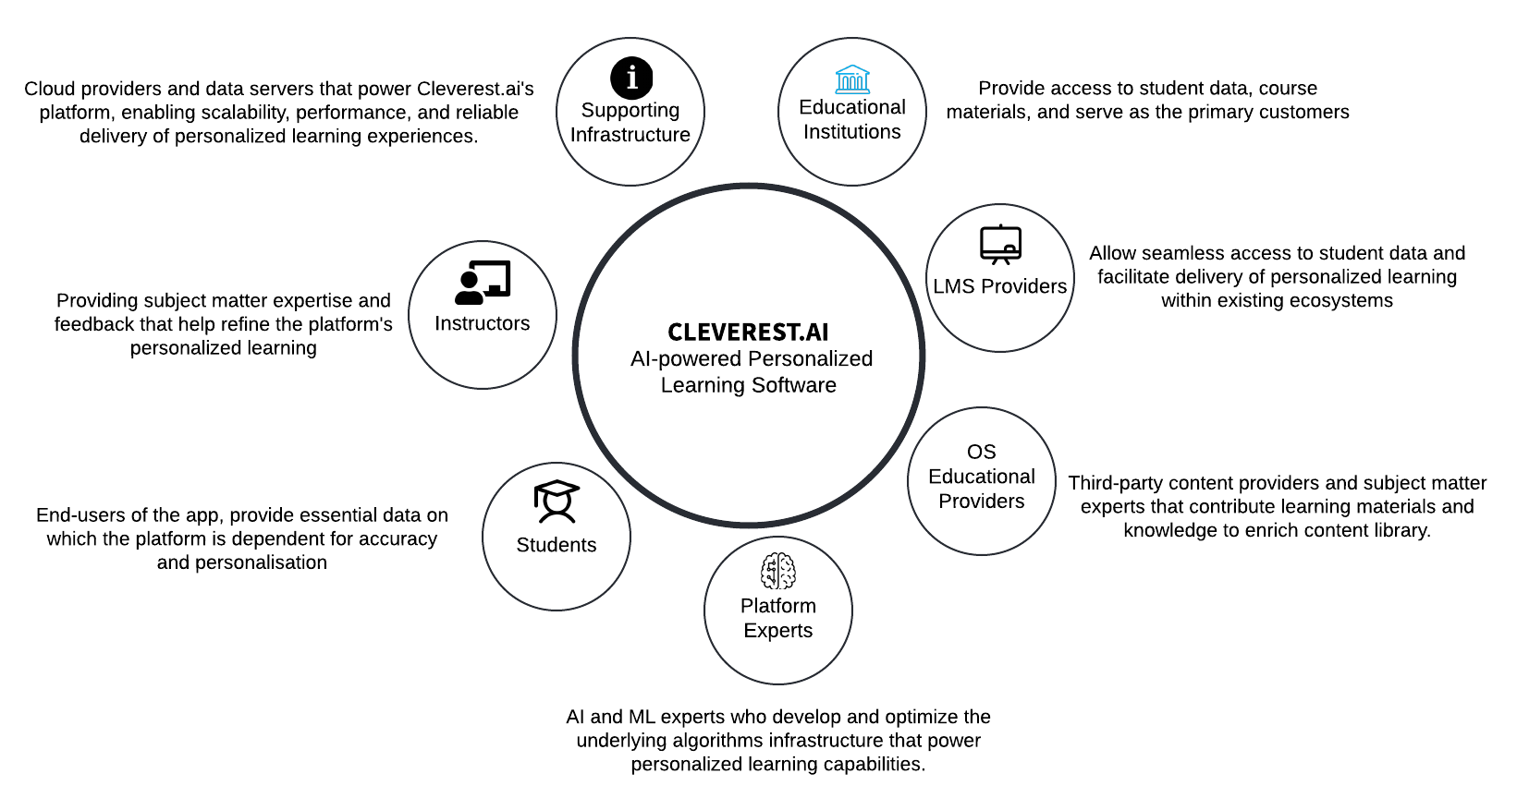
Value Network
Notes:
Supporting Infrastructure: Cloud providers and data servers that power the platform, enabling scalability, performance, and reliability of personalized learning experiences.
Educational Institutions: Provide access to student data, course materials, and serve as the primary customers.
Instructors: Providing subject matter expertise and feedback that help refine the platform's personalized learning.
LMS Providers: Allow seamless access to student data and facilitate delivery of personalized learning within existing ecosystems.
Open-Source Educational Providers: Third-party content providers and subject matter experts that contribute learning materials and knowledge to enrich content library.
Students: End-users of the app, provide essential data on which the platform is dependent for accuracy and personalisation.
Platform Experts: AI and ML experts who develop and optimize the underlying algorithms infrastructure that power personalized learning capabilities.

Slide 9
Strategy Summary
Advanced AI/ML Algorithms
Targeting early adopters
LMS integration to leverage student data
Freemium pricing model
Dedicated R&D team
Notes:
Advanced AI/ML Algorithms allow the company to provide an in-depth, accurate, and personalized learning experience to its users as compared to competitors.
By targeting early adopters in educational institutions and instructors familiar with LMS platforms (especially in the tech-savvy online teaching segment), Cleverest.ai can gather valuable feedback and refine their platform quickly, potentially outpacing competitors focused on a broader audience.
Integrating with LMS allows Cleverest to leverage student data for in-depth personalization and adaptive learning paths, which positions Cleverest.ai to offer a more tailored experience than competitors.
The freemium subscription model can attract new users with a lower barrier to entry, leading to ‘crossing the chasm’, higher switching costs, and stronger network effects compared to competitors with paid models.
Dedicated R&D team to improve value proposition and sustain competitive advantage.

